Slide 1
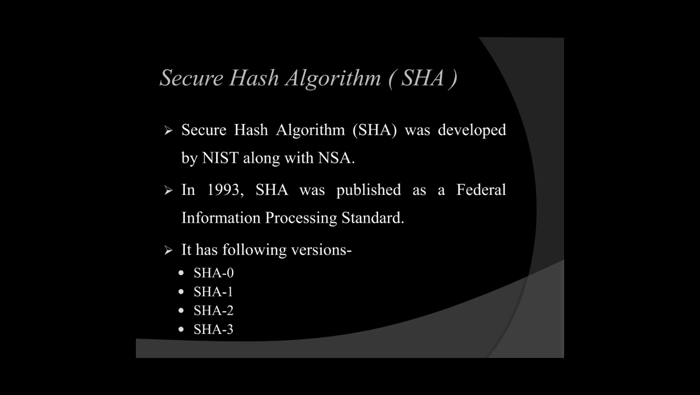
SHA-1 (Secure Hash Algorithm 1)
Definition:- It is a cryptographic hash algorithm that takes an input message of any length and produces a fixed-size 160-bit message digest, usually represented as a 40-character hexadecimal value. It processes the message in 512-bit blocks and uses 80 processing rounds.

Slide 2
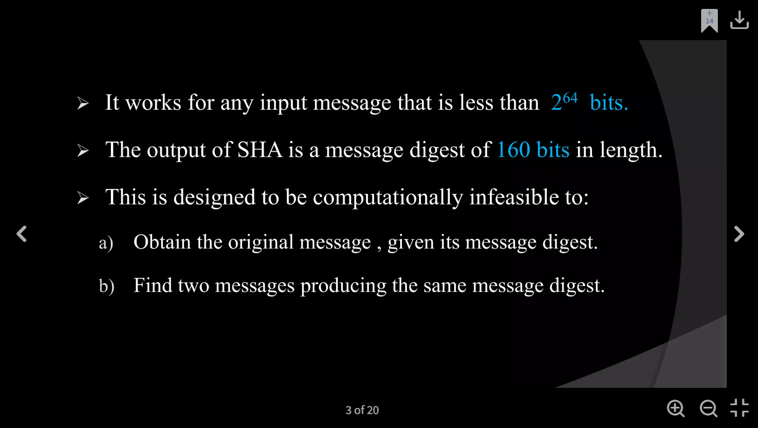

Slide 3
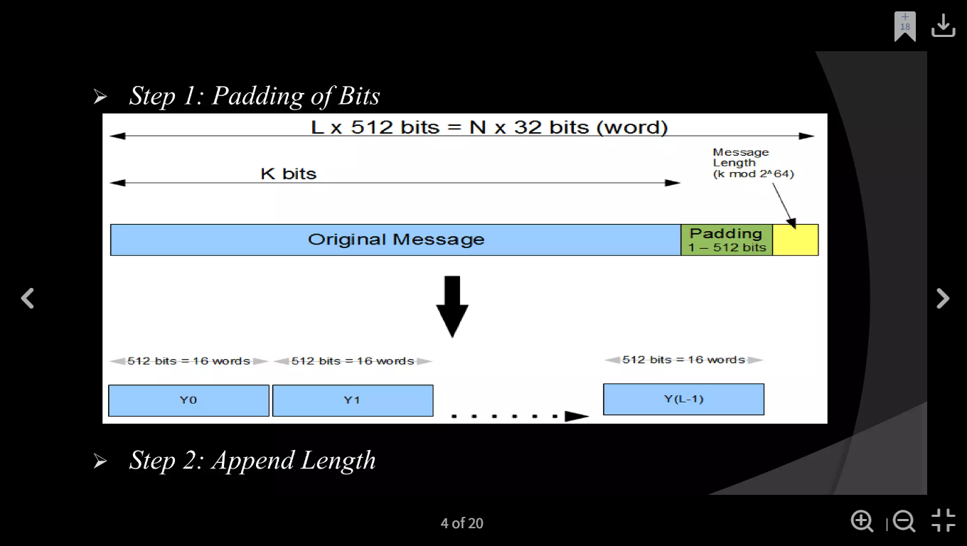
Working of SHA1
Step 1:-
Padding:- Adding a 1 bit followed by enough 0 bits to make the message length 448 bits modulo 512.

Slide 4
Step 2:-
Appending Length: Adding the 64-bit representation of the original message length to make the final block 512 bits.
Step 3:-Divide the Input into 512-bit Blocks
Definition: After padding and appending the 64-bit message length, the complete message is divided into 512-bit blocks for SHA-1 processing.
Each 512-bit block contains:
512 bits = 16 × 32-bit words
Example:
Padded + Lengthened Message
Y0(512) | Y1(512) | ……… | Y(L-1)(512)

Slide 5
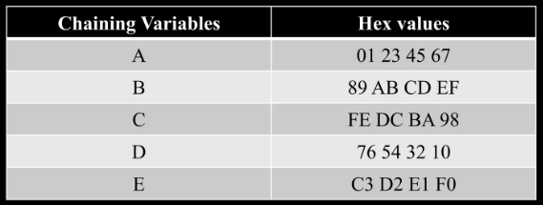
Step 4:-Initialize Chaining Variables
Definition: SHA-1 initializes five 32-bit chaining variables with fixed hexadecimal constants before processing the 512-bit message blocks.
These five variables together form the 160-bit intermediate hash value.

Slide 6
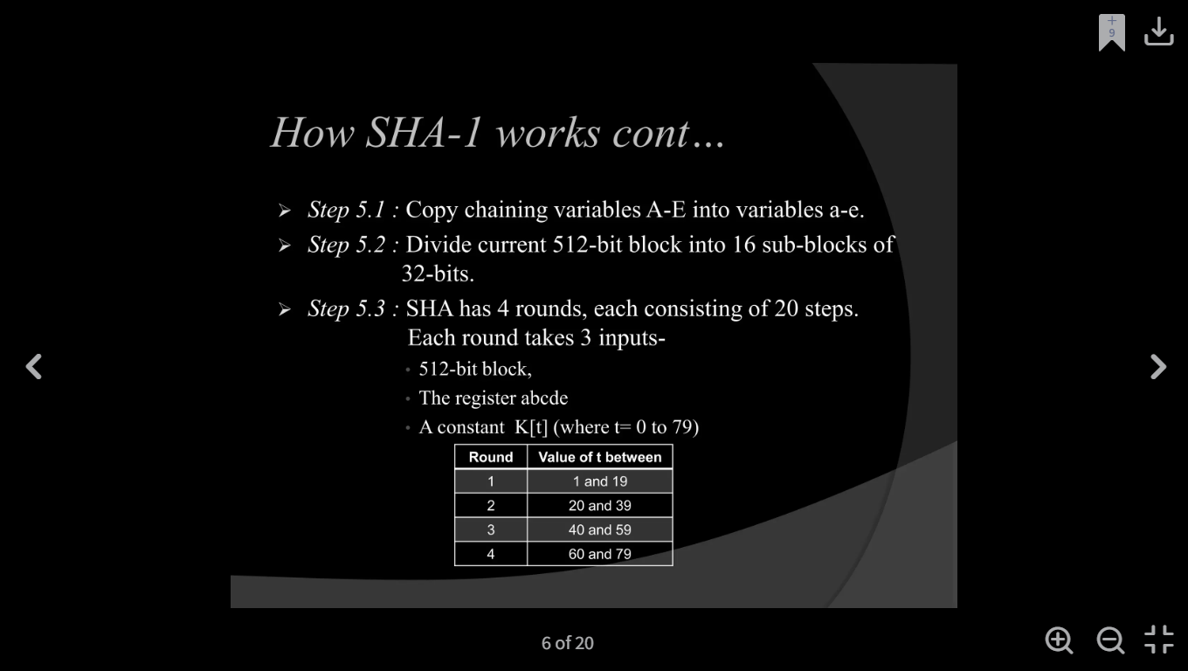
Step 5:- Process Block and Output
Process Block: Each 512-bit message block is processed through 80 rounds using the five working variables A, B, C, D, and E.
Output: After all blocks are processed, the final values of H₀, H₁, H₂, H₃, and H₄ are combined to produce the 160-bit SHA-1 message digest.

Slide 7
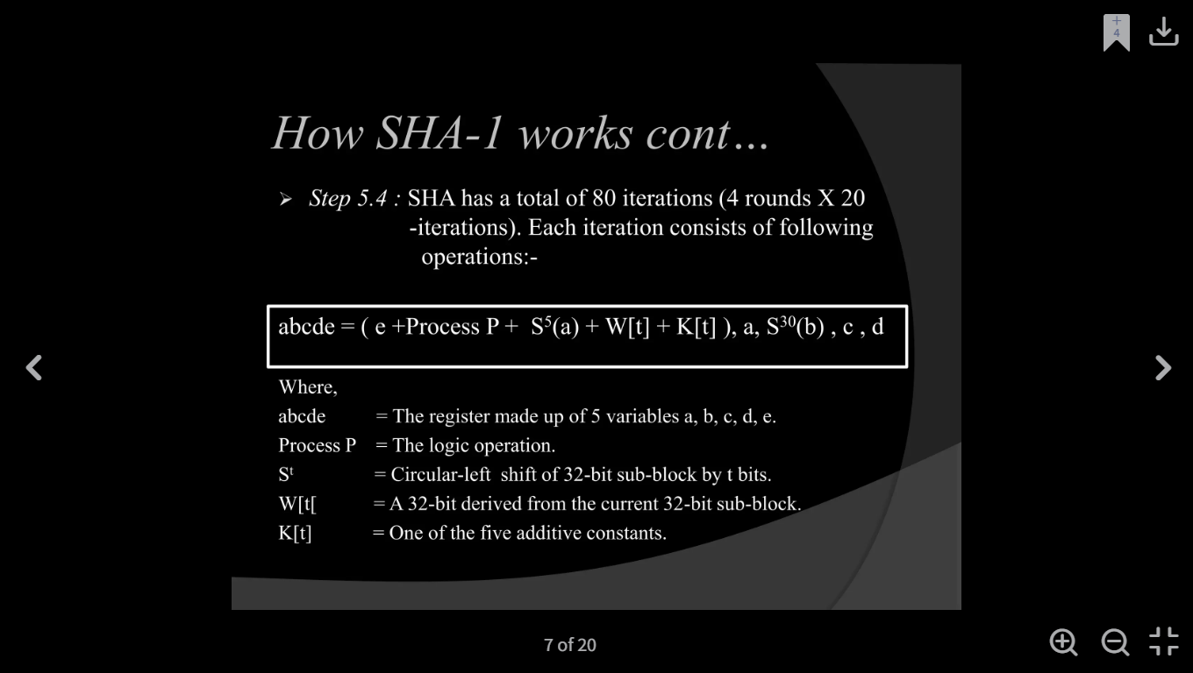

Slide 8
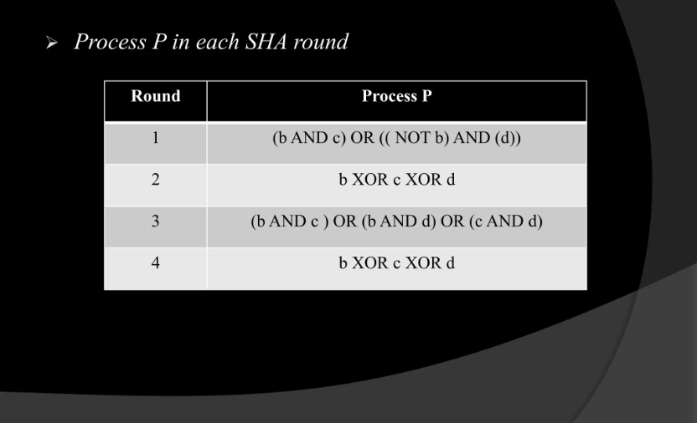

Slide 9
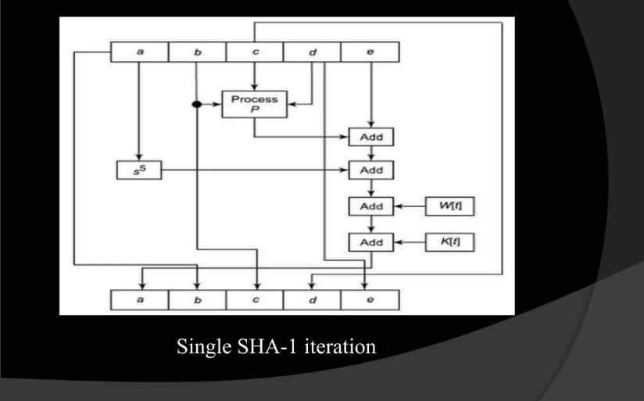

Slide 10
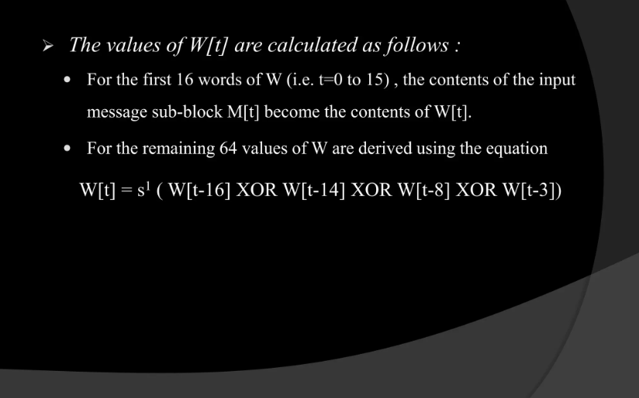

Slide 11
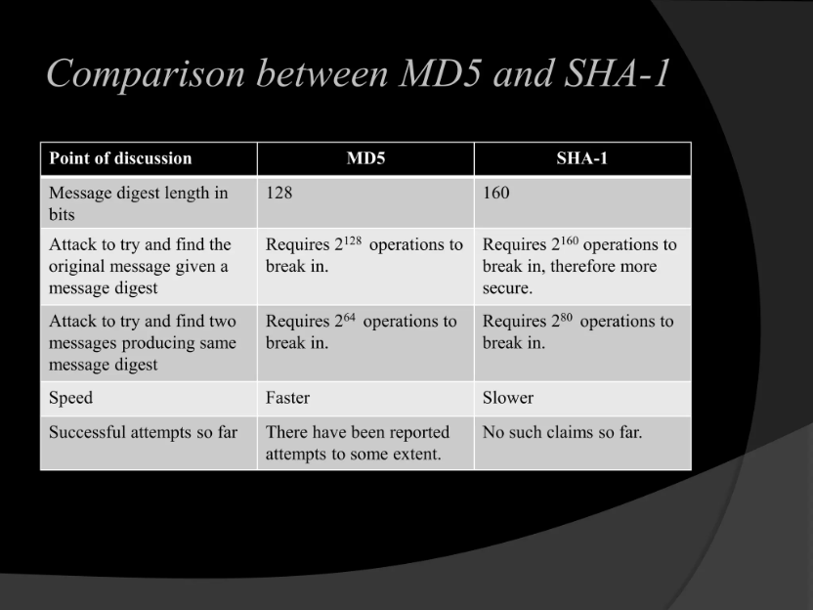

Slide 12
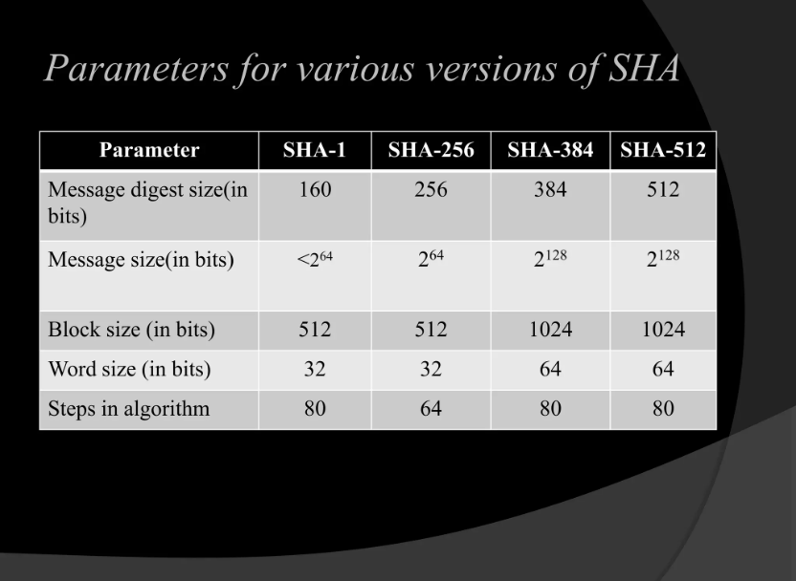

Slide 13
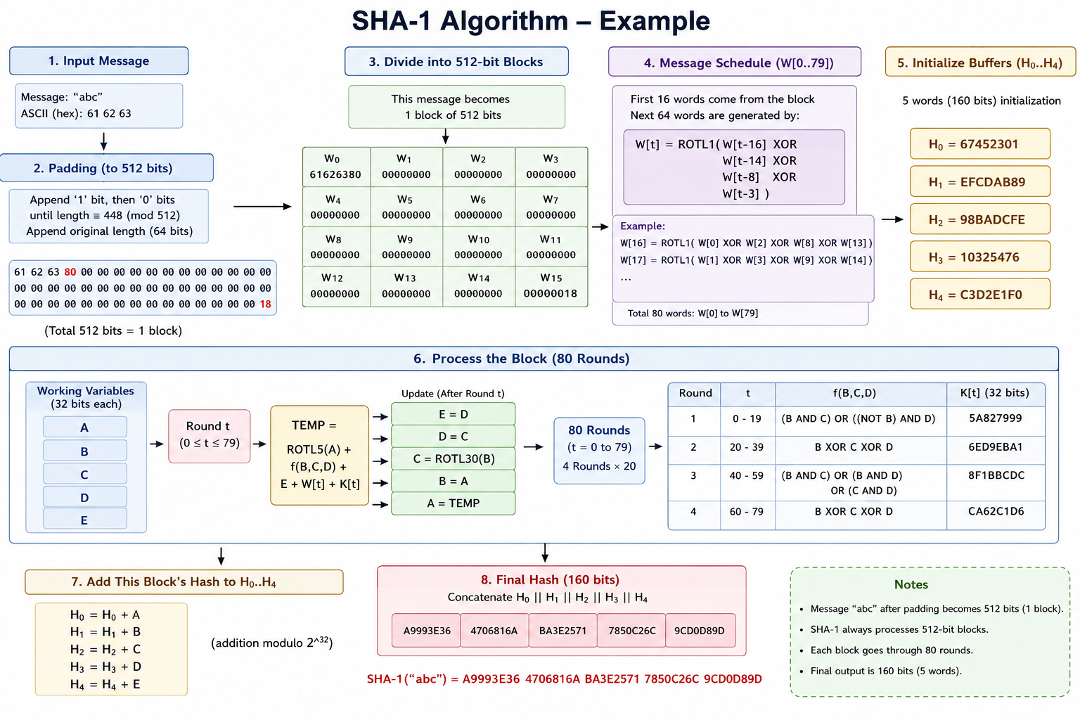

Slide 14
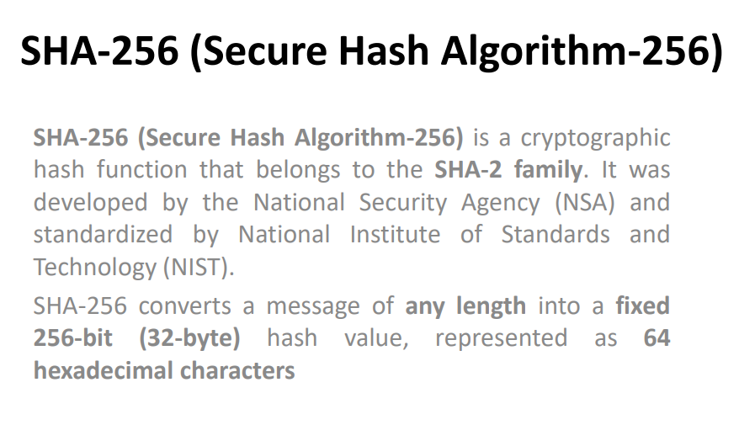

Slide 15
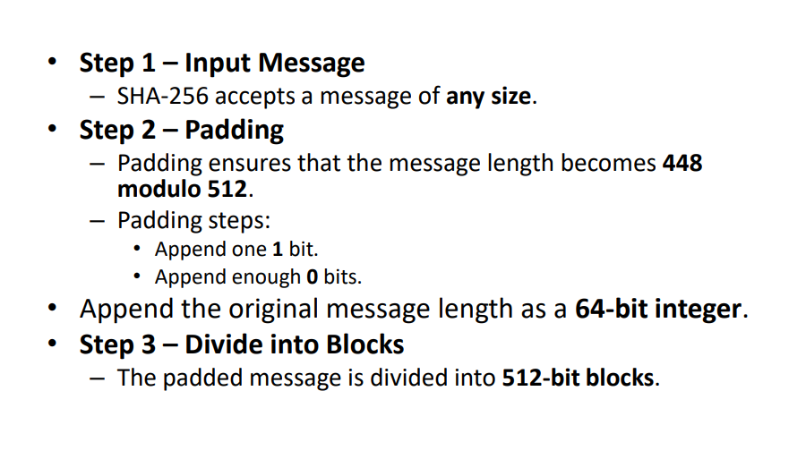

Slide 16
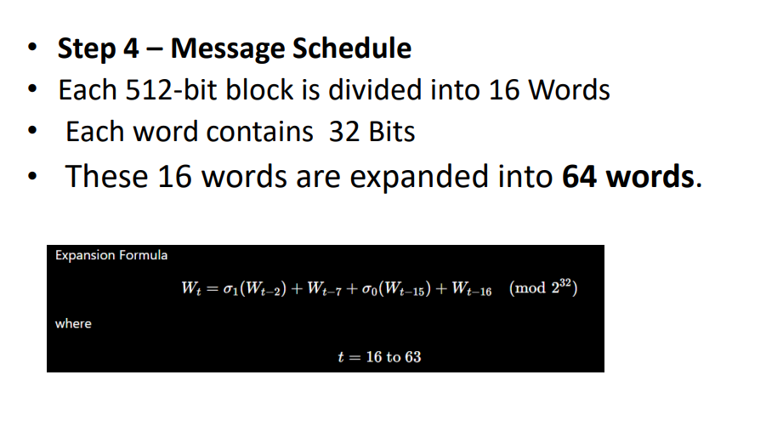

Slide 17
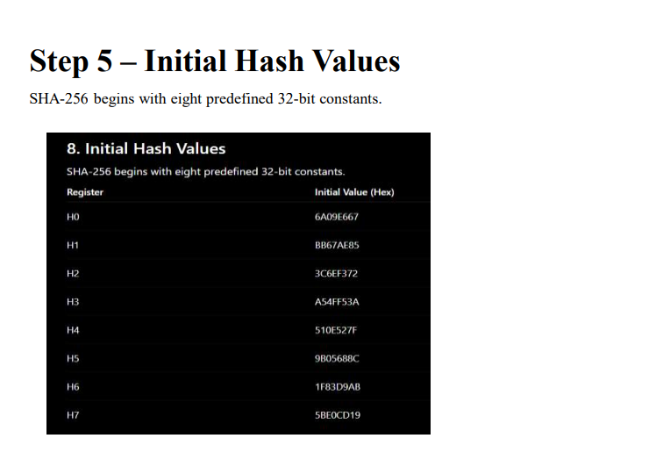

Slide 18
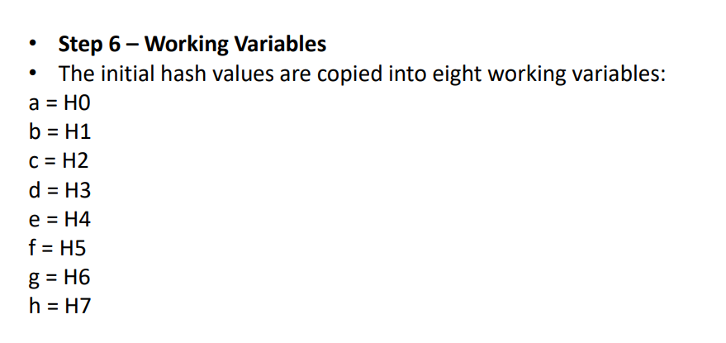

Slide 19
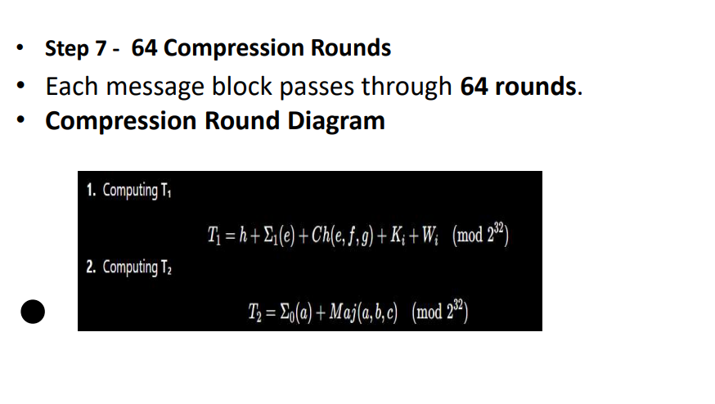

Slide 20
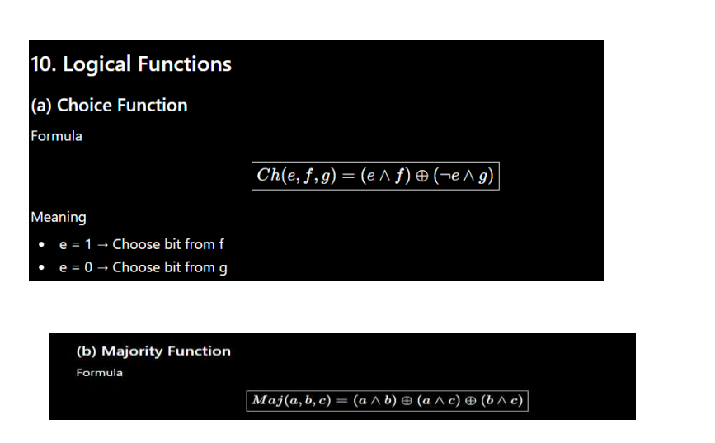

Slide 21
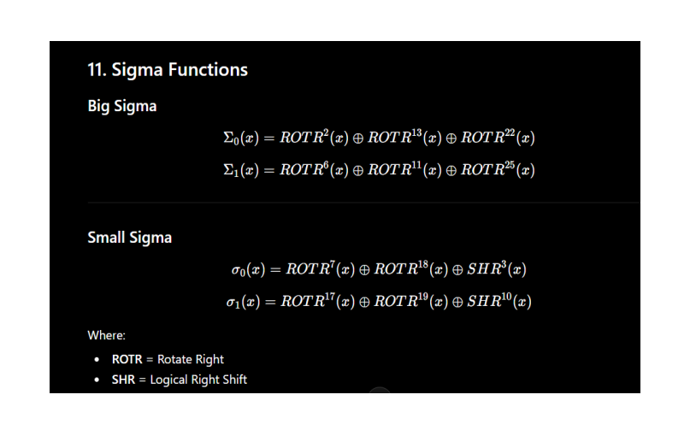

Slide 22
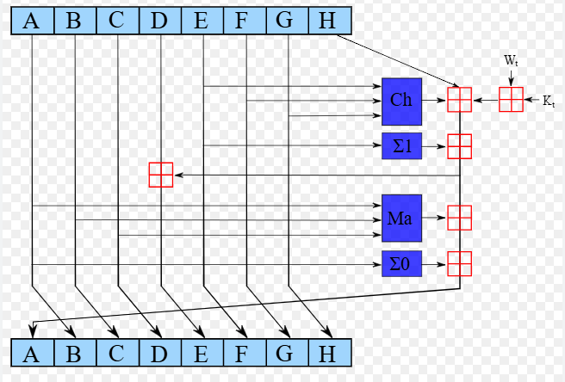

Slide 23
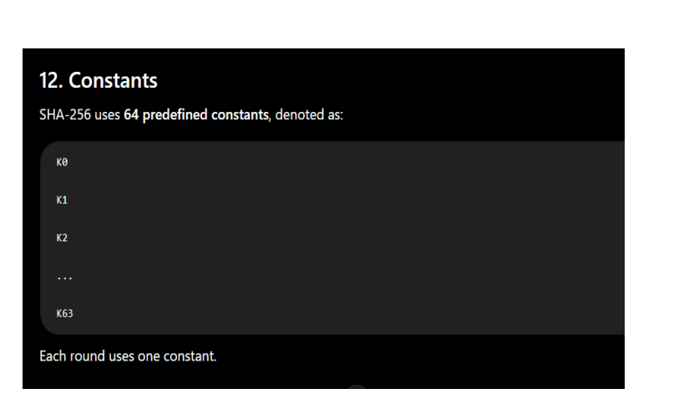

Slide 24
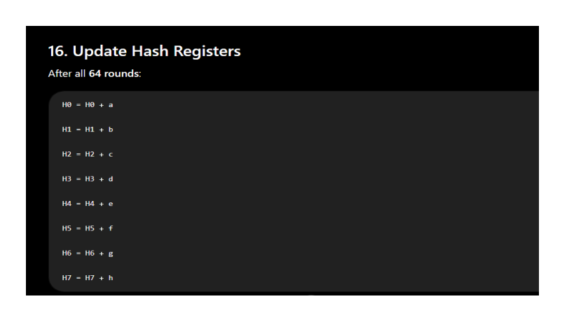

Slide 25
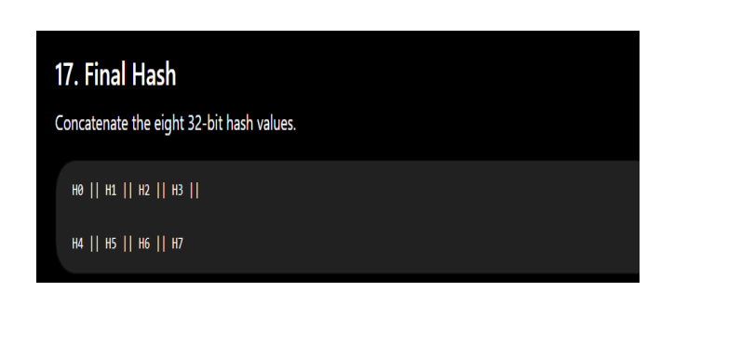

Slide 26
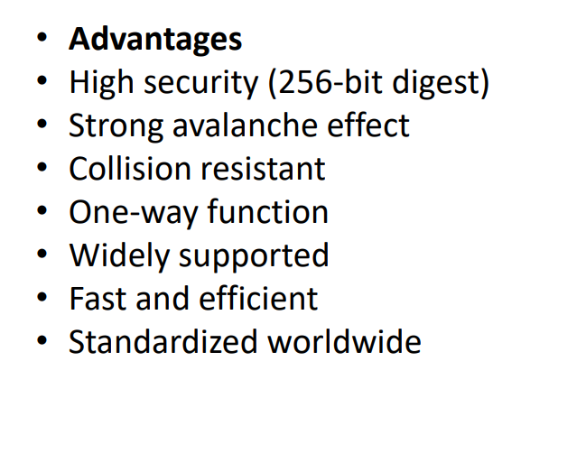

Slide 27
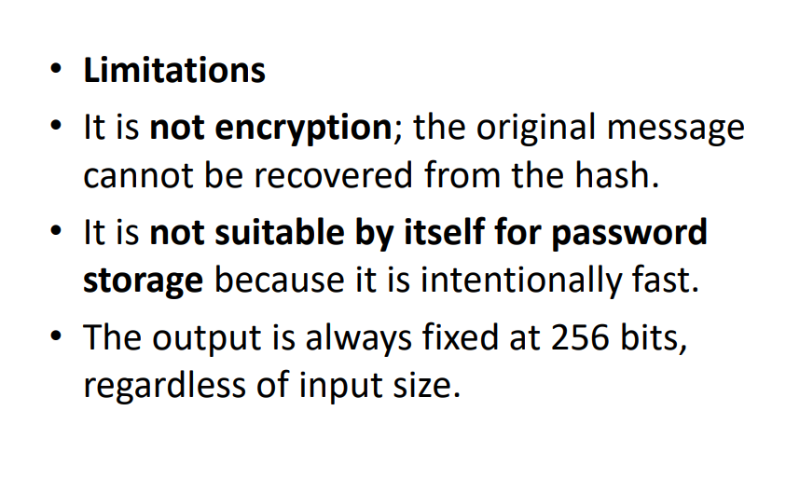

Slide 28
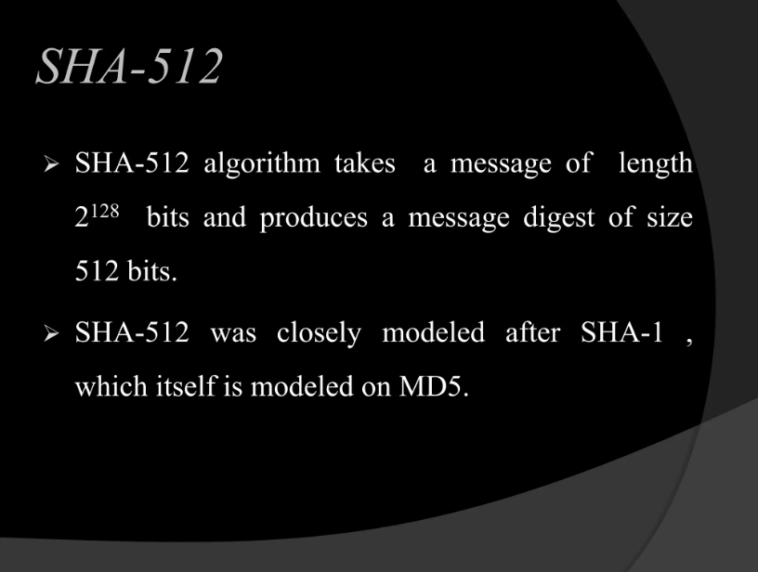

Slide 29
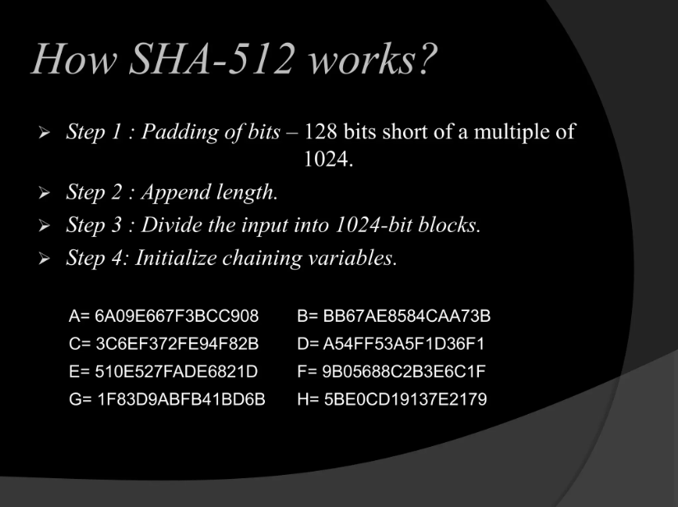

Slide 30
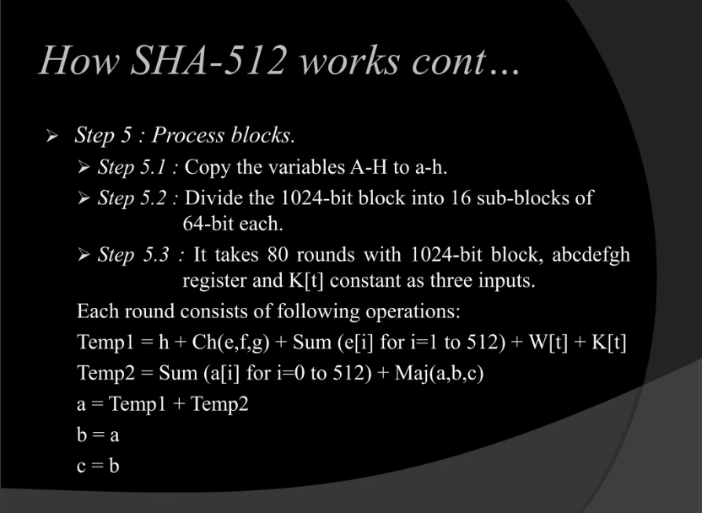

Slide 31
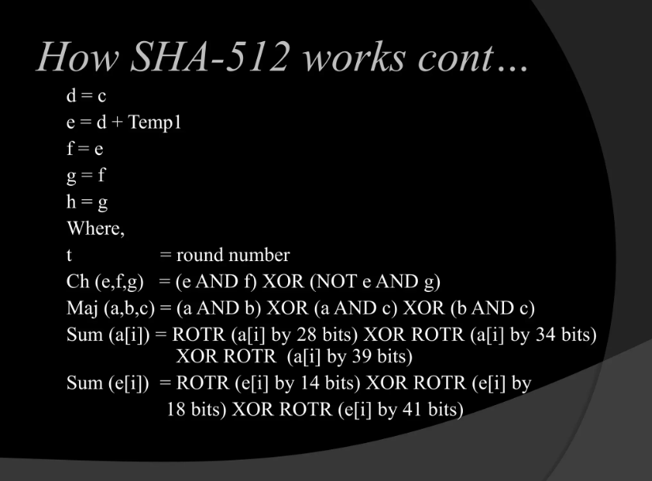

Slide 32
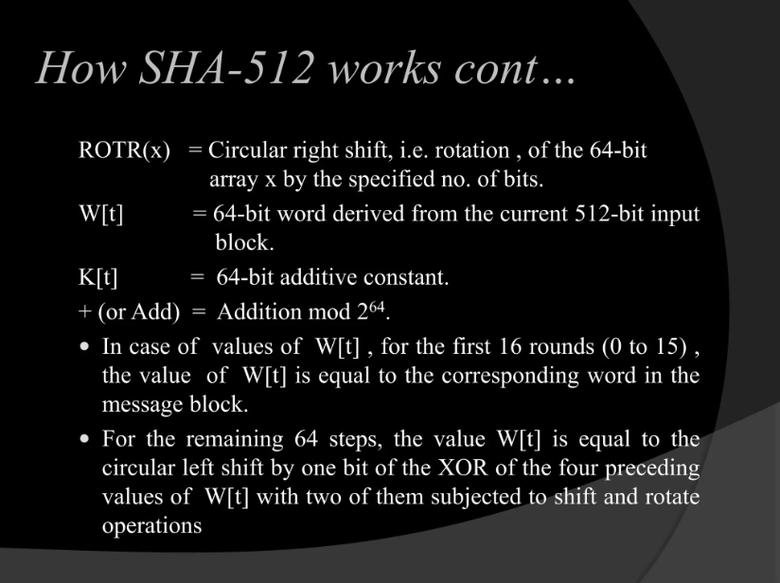

Slide 33
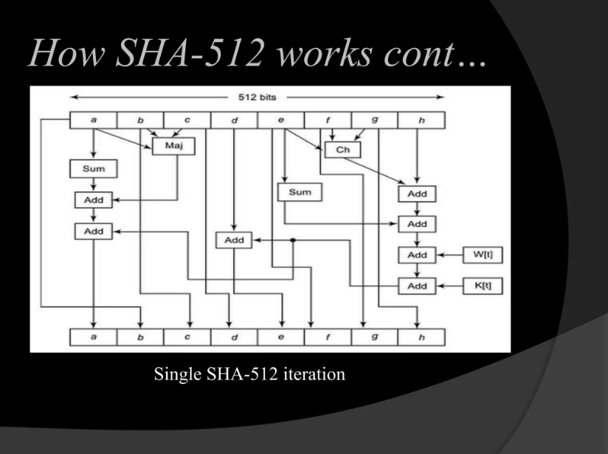

Slide 34
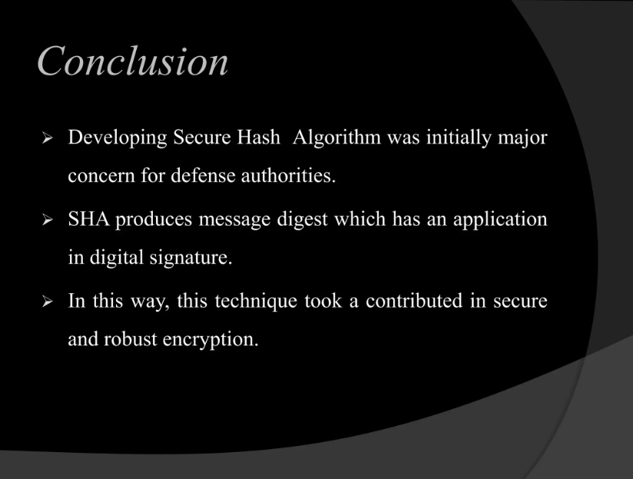

Slide 35
Steganography
Steganography is a method of hiding secret data, by embedding it into an audio, video, image, or text file. It is one of the methods working to protect secret or sensitive data from malicious attacks.
Cryptography and steganography are both methods used to hide or protect secret data. However, they differ in the respect that cryptography makes the data unreadable, or hides the meaning of the data, while steganography hides the existence of the data.
Image Steganography –
Image Steganography refers to the process of hiding data within an image file. The image selected for this purpose is called the cover image and the image obtained after steganography is called the stego image.

Slide 36
How is it done?
An image is represented as an N*M (in case of grayscale images) or N*M*3 (in case of color images) matrix in memory, with each entry representing the intensity value of a pixel.
In image steganography, a message is embedded into an image by altering the values of some pixels, which are chosen by an encryption algorithm.
The recipient of the image must be aware of the same algorithm in order to know which pixels he or she must select to extract the message

Slide 37
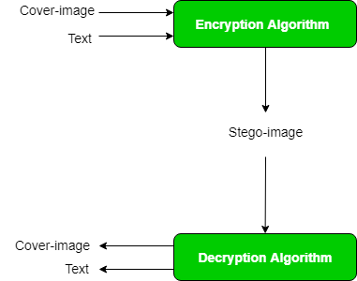

Slide 38
steganography approach involves cover a huge amount of data (picture, audio, and text) within a colour bitmap (bmp) image.
The image will be filtered and segmented with bits replacement applied to the appropriate pixels. These pixels are chosen at random rather than in order.
Detection of the message within the cover image is done by the process of steganalysis.
This can be done through comparison with the cover image, histogram plotting, or noise detection.
Efforts are being invested in developing new algorithms with a greater degree of immunity against such attacks,
Efforts are also being dedicated towards improving existing algorithms for steganalysis, to detect the exchange of secret information between terrorists or criminal

Slide 39
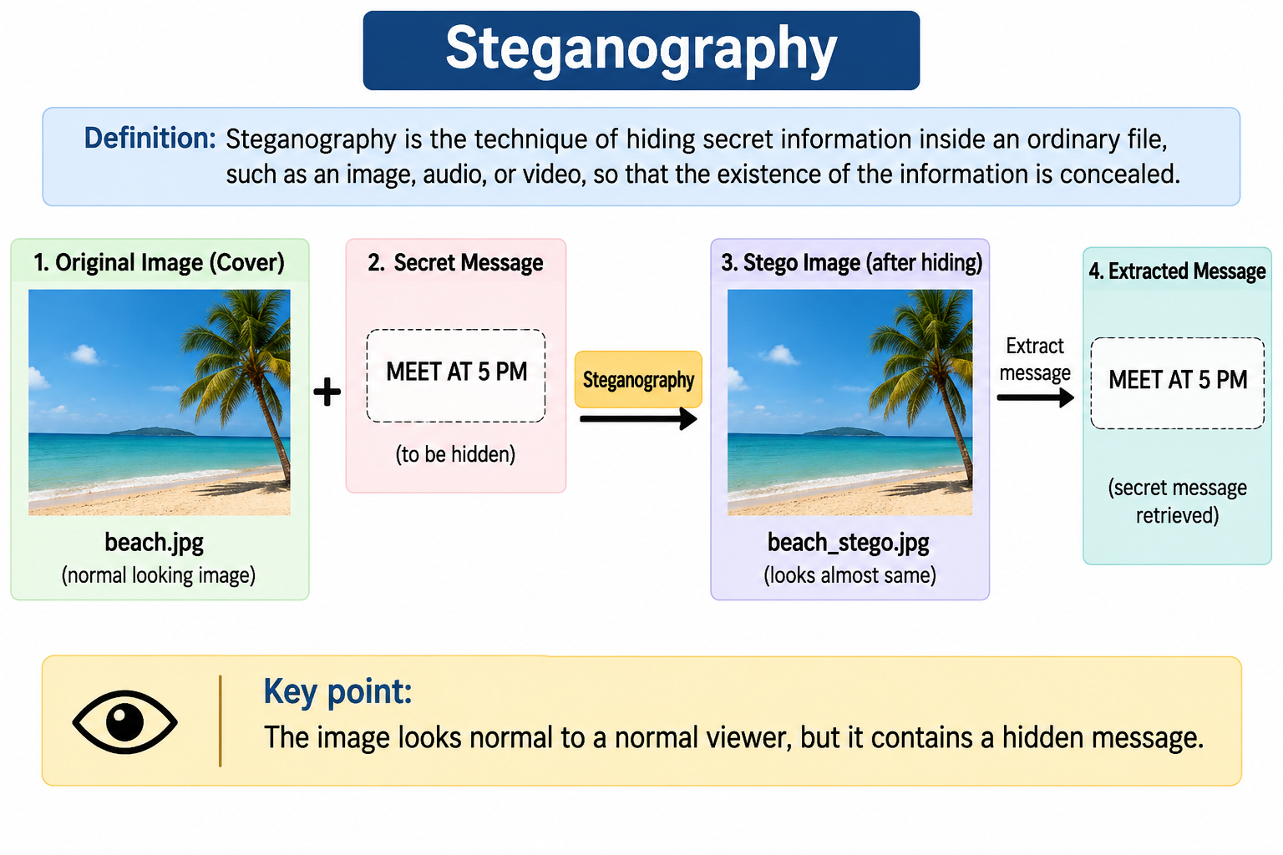

Slide 40
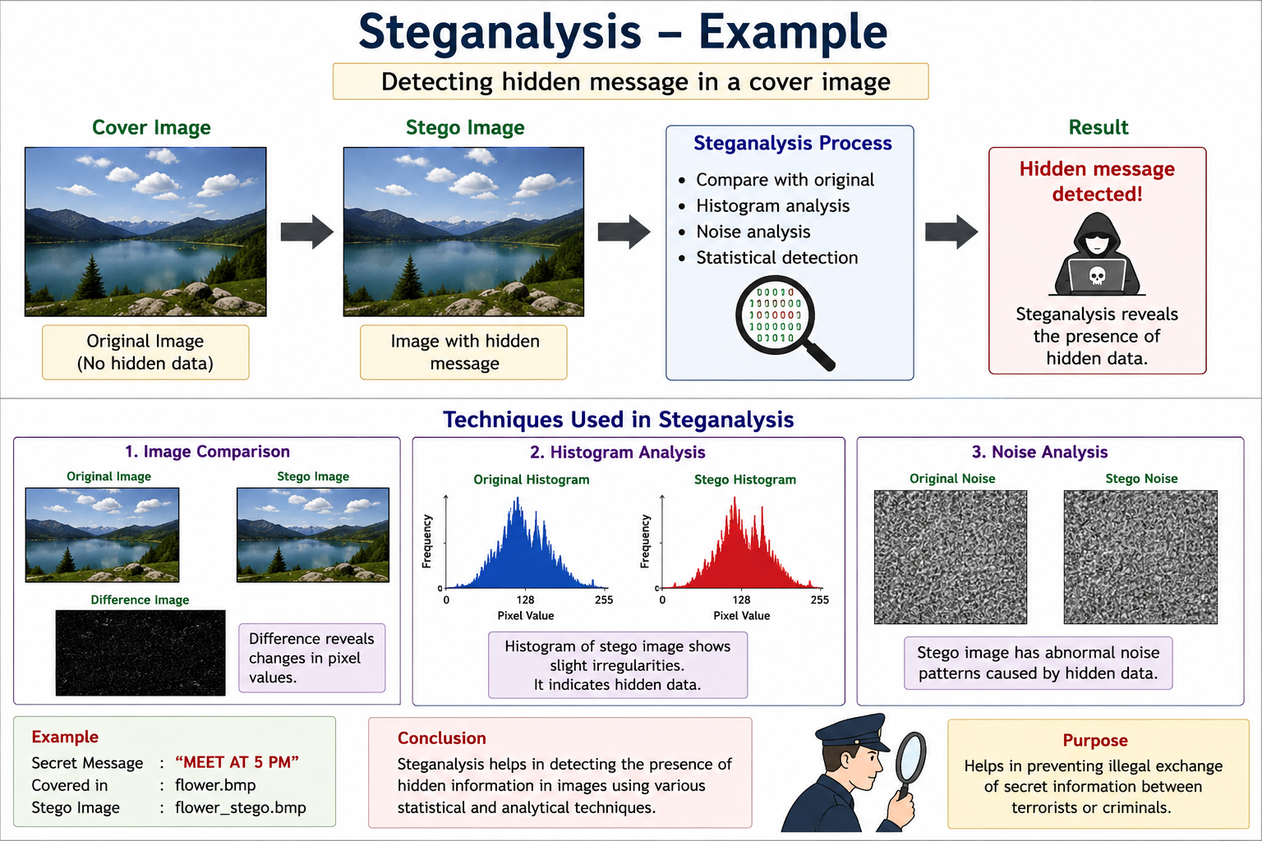

Slide 41
Course Outcomes (COs)
Upon completion of course the students will be able to
Apply cryptographic techniques and digital signature protocols

